Slide 1
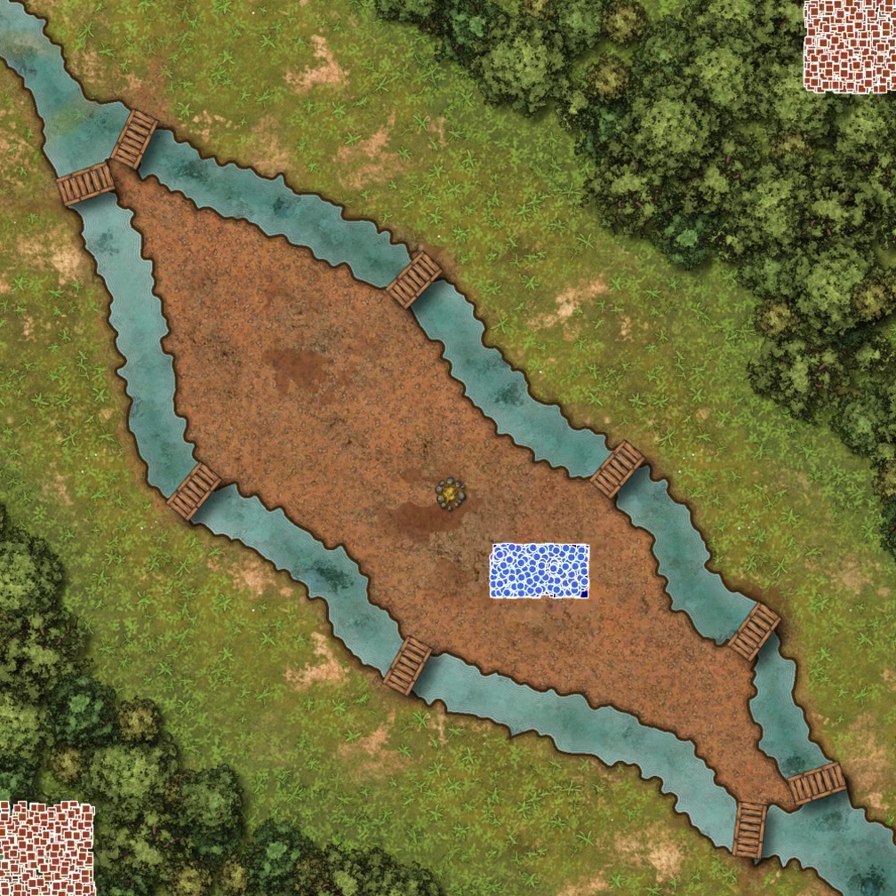
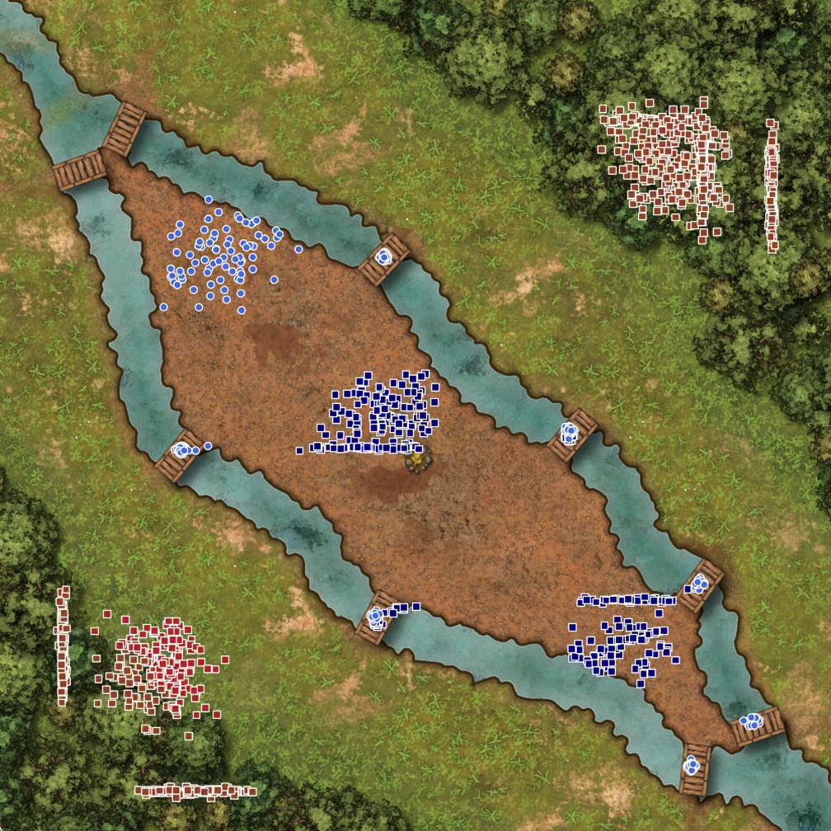
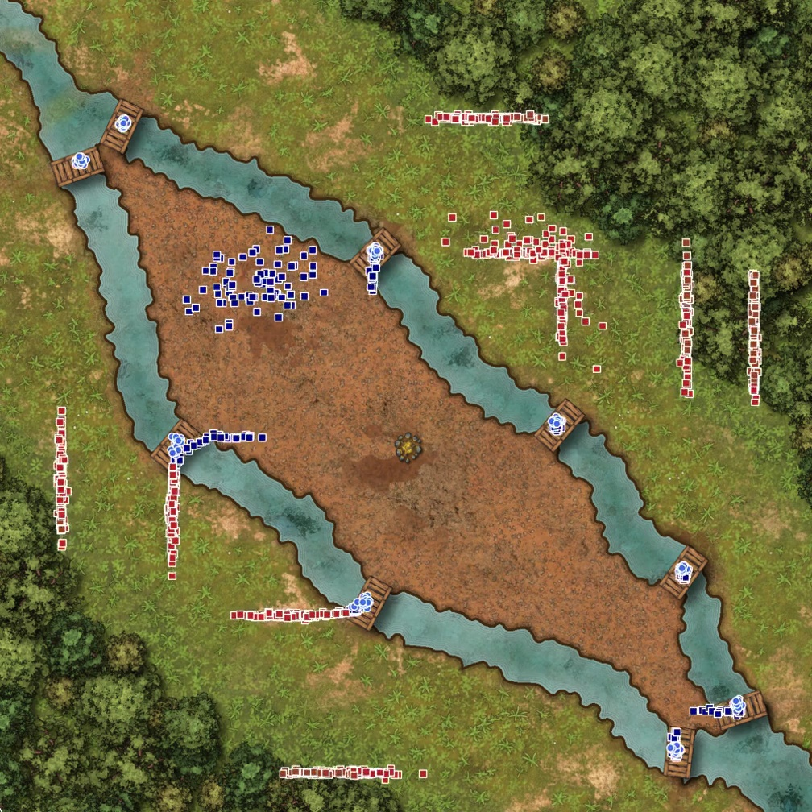
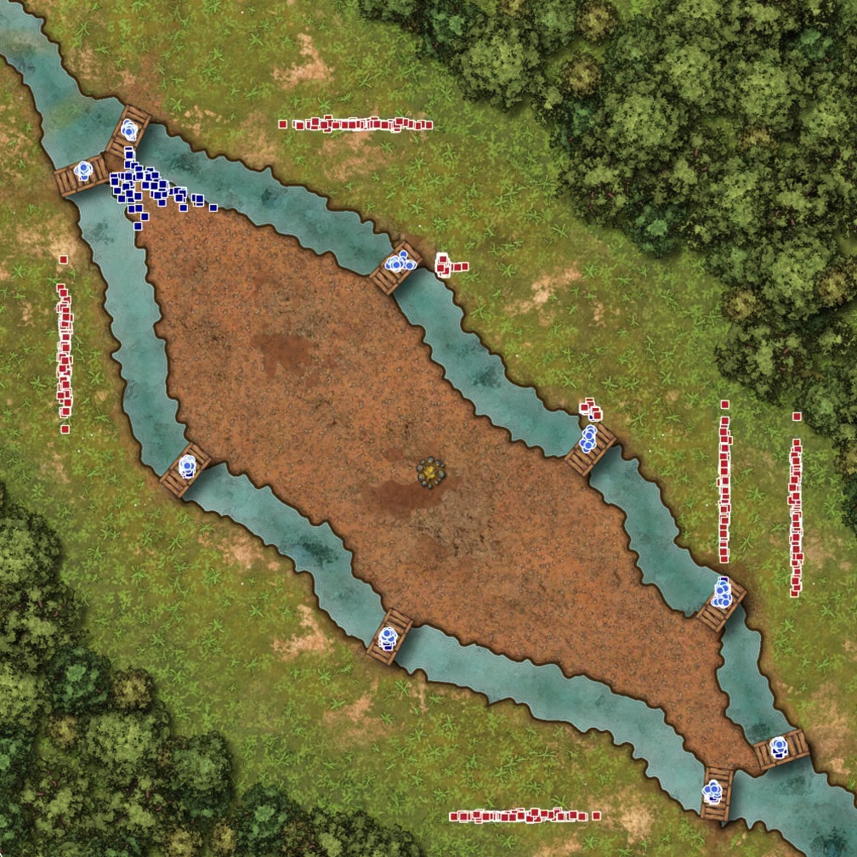
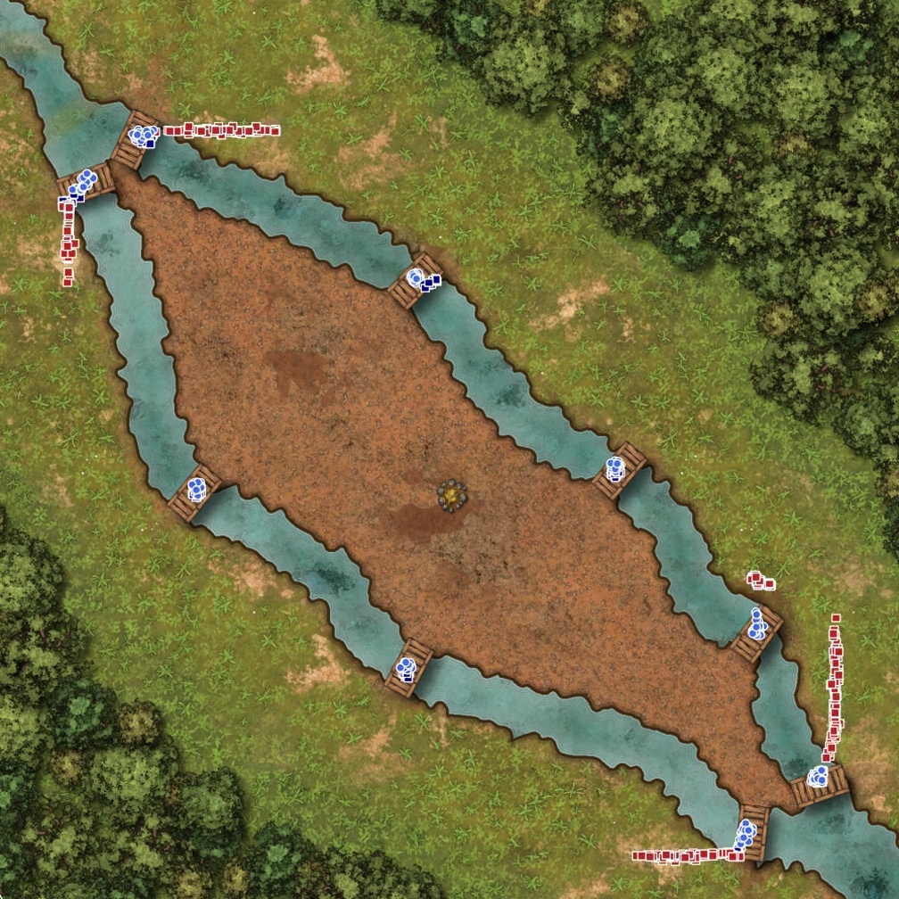
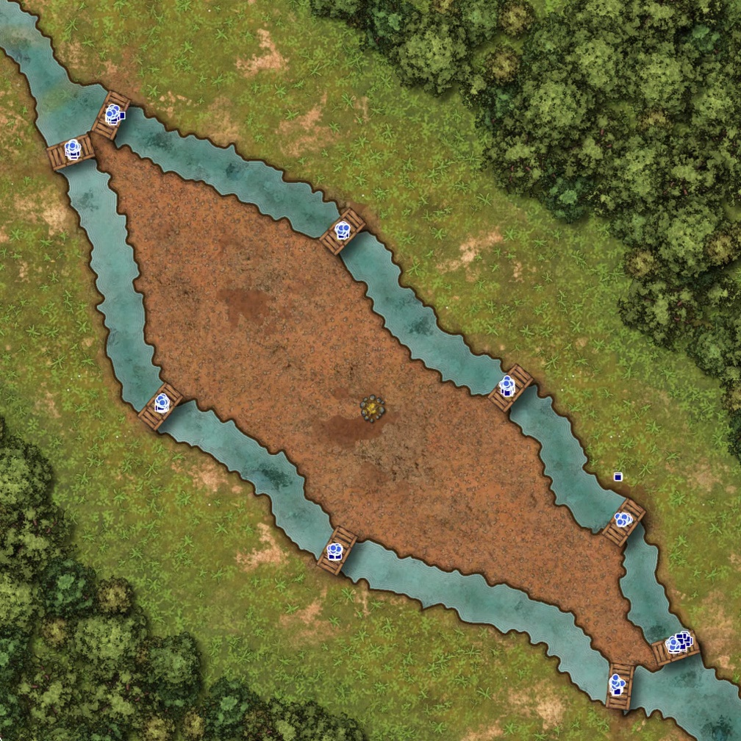
Player
Write a plan to split our army on all the bridges to protect them and make sure to send archers and close-range units on each bridge.
I'll help you create a defensive plan to protect the bridges using a combination of spearmen and archers. Looking at the map, we have 10 bridges in total (5 on the Northern River and 4 on the Southern River) that need to be defended. Let's analyze our forces: Spearmen (IDs 0-349): 350 units and Archers (IDs 350-699): 350 units. We can split them into 9 groups (one for each bridge) with approximately 39 spearmen and 39 archers each.
[Gives the actual plan following a domain-specific language] This plan:
1. First positions our forces at all bridges, with:
- Spearmen in front (at the bridge level)
- Archers slightly behind them (2 units back) to provide ranged support
2. Each bridge gets approximately 39 spearmen and 39 archers
3. The archers are set to attack_static to maintain their position and use their range advantage
4. The spearmen are set to attack_in_close_range to engage any enemies that get close
5. Once all units are in position (Step 1), they will defend their positions while focusing on eliminating enemy units, with the center point (150, 134) as a fallback position if needed
HIVE

